Slide 1



How Your Health May Be Related to What Your Governor Says
Exploring relationships between indicators and social determinants of health, and the emotional sentiments of elected leaders
IST 707 Data Analytics: John Christman, Christina DaSilva , Christopher Hart, Jorge Martinez
Notes:
Our health & well-being, and the welfare of those we love and care about, is certainly top of mind these days. And each day, we must wade through a volume of information coming from – friends, colleagues, medical professionals, and elected leaders.
It is this later group, our elected leaders, and specifically the Governors of our states, that emerged as an initial focal point for our project. We had an interest in better understanding if what our elected leaders said – the emotions and sentiments that they expressed – had any influence on how we felt from a health and well-being perspective.

Slide 2
The usefulness of the information we gather and effectiveness of the actions we might take is dependent upon the quality of the questions that we ask.
Notes:
And so we began designing and exploring a series of questions based on the adage…

Slide 3
What our Governors are saying.
What emotions and sentiments are conveyed by our elected leaders when addressing those living in their state?
Notes:
Our first question was designed simply to recognize what they were saying - what emotions and sentiments were being conveyed when addressing those living in their state?
Each year, in this case from January 2019, state Governors give an address which is a state of the state – a reflection on the past year and an outlook for the year ahead.

Slide 4
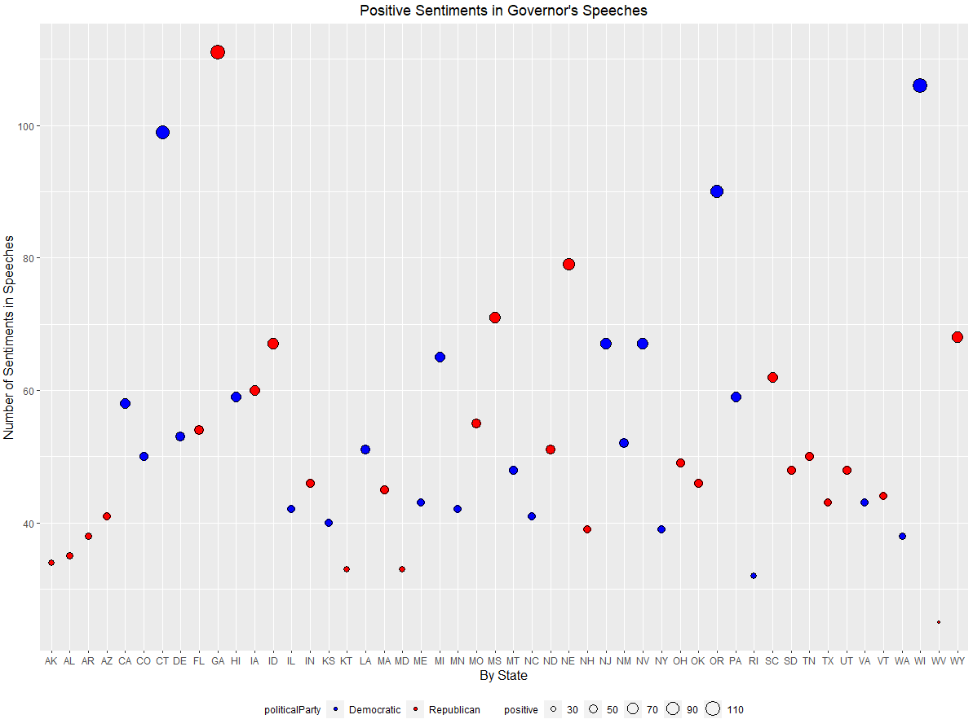
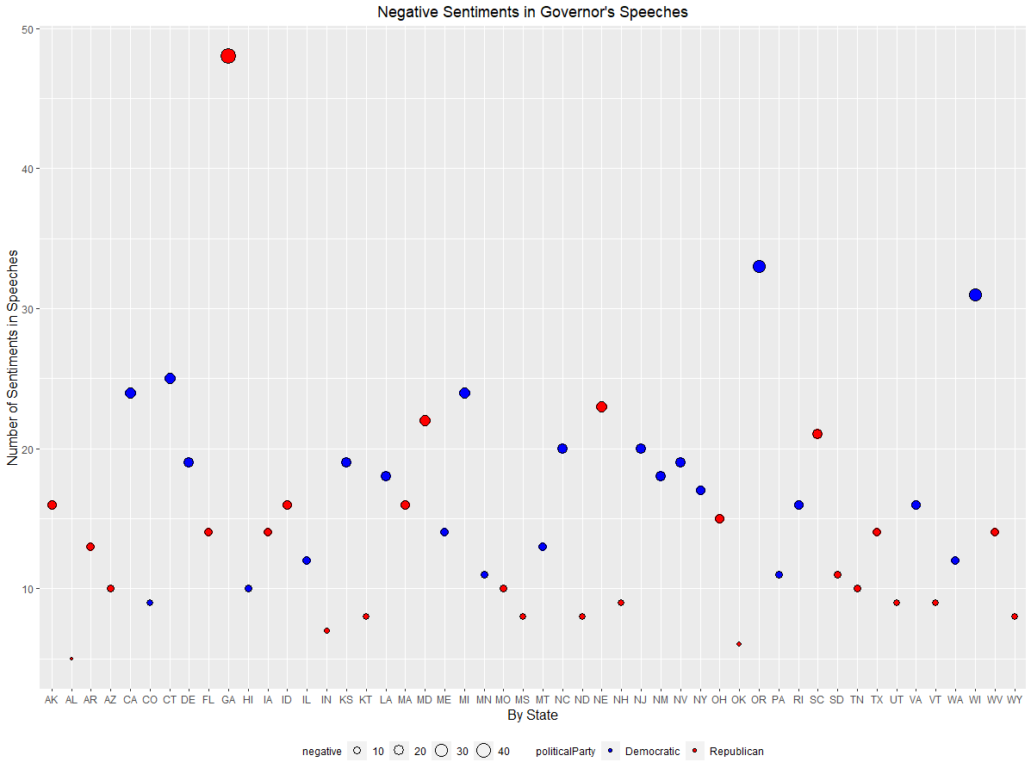
Negative Sentiments in Governor’s Speeches
Positive Sentiments in Governor’s Speeches
Notes:
As you might expect given that they are politicians, the number of positive sentiments in any given speech was significantly higher than its negative sentiments (except for Governor Brian Kemp of Georgia).
But what is interesting about sentiments is that…

Slide 5
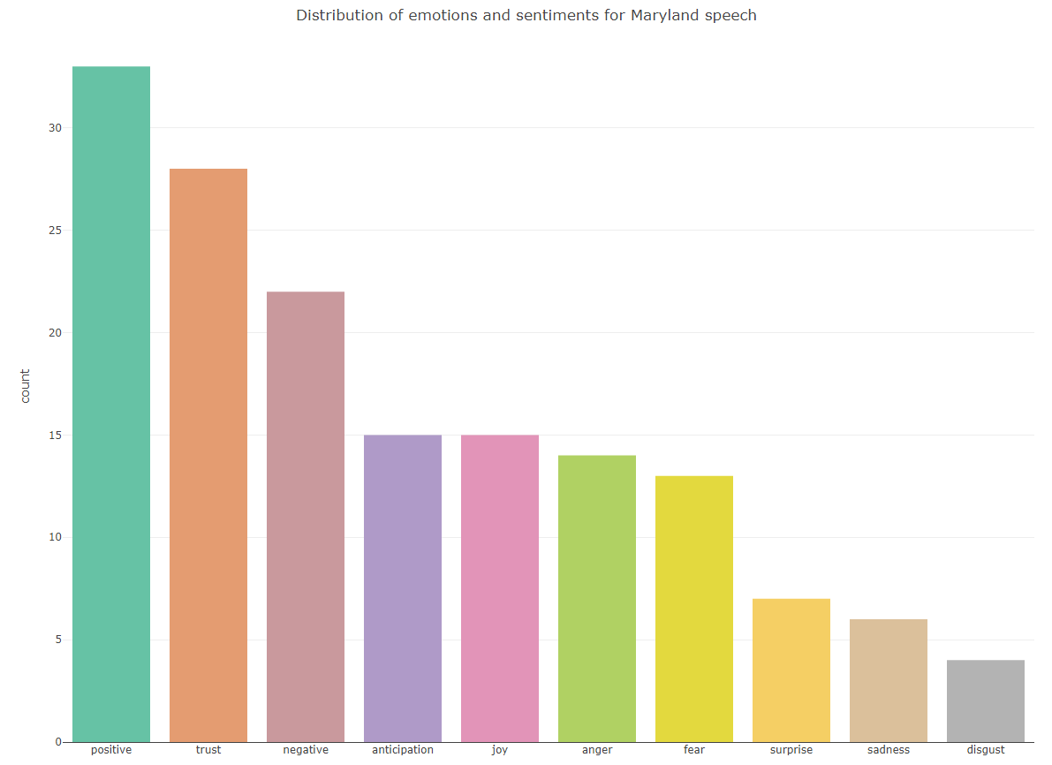
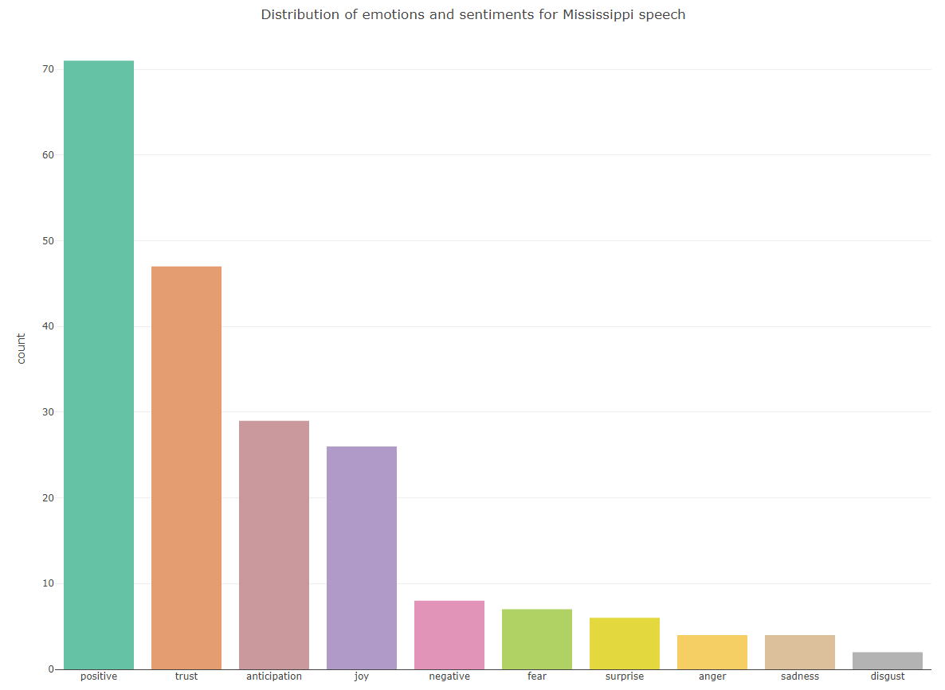
60.0% of Governor Larry Hogan’s Speech from the State of Maryland was Positive
89.9% of Governor Phil Bryant’s Speech from the State of Mississippi was Positive
Notes:
…underneath them are actual words and related emotions that create sentimental attitudes as illustrated in MD & MI speeches which reflected the low and high end of positivity.
[TRANS]
The difference is driven by the emotions of anger and fear.

Slide 6
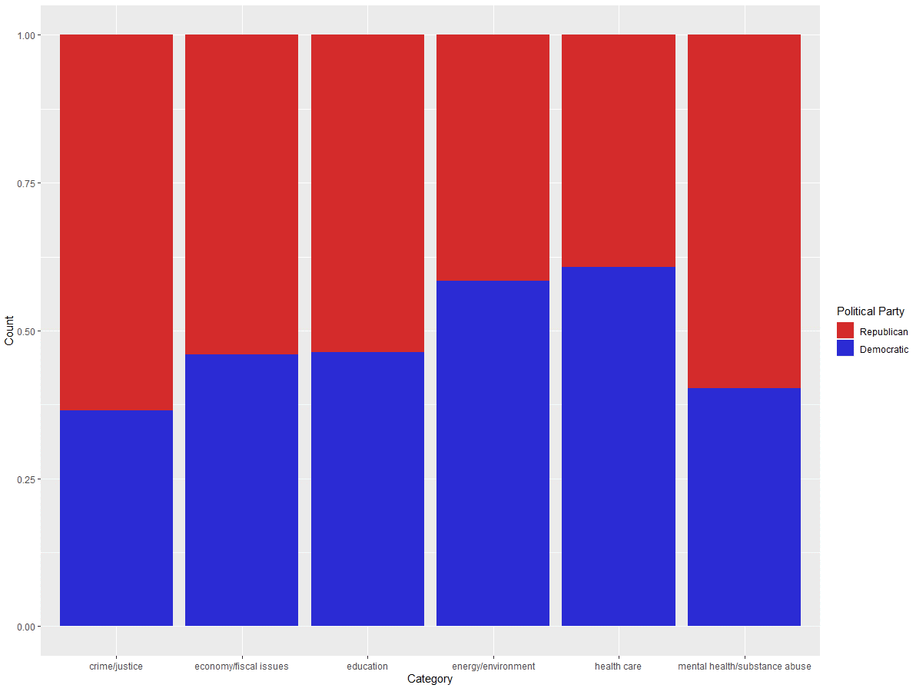
Beyond the words and sentiments, political parties emphasize certain thematic categories:
Crime/Justice
Economy/Fiscal Issues
Education
Energy/Environment
Health Care
Mental Health/Substance Abuse
Notes:
And then, finally, beyond the words, emotions, and sentiments is the reminder that our elected leaders belong to political parties. And each party appears to place emphasis on different issues that can directly impact our health and well-being at a community level.
This initial inquiry into what our elected leaders were saying was then coupled with our second question about how we might be feeling…(Christina)

Slide 7
How we are feeling.
What are the key indicators and social determinants of health that elected leaders may be responding or reacting to when delivering a speech?

Slide 8
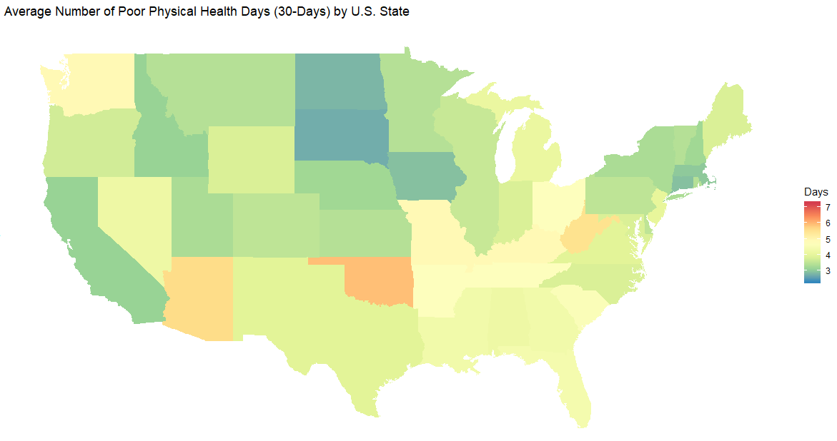
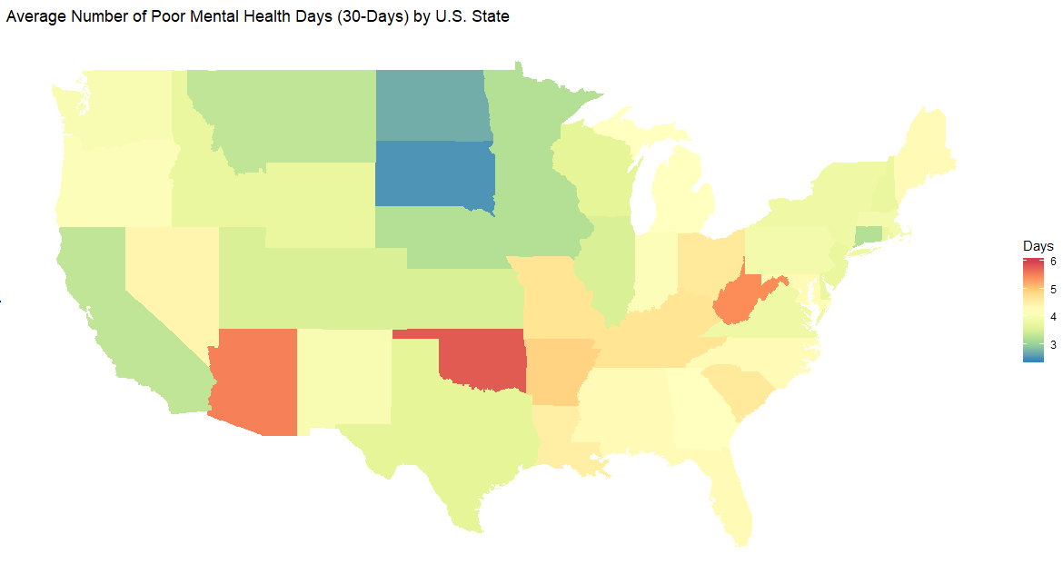
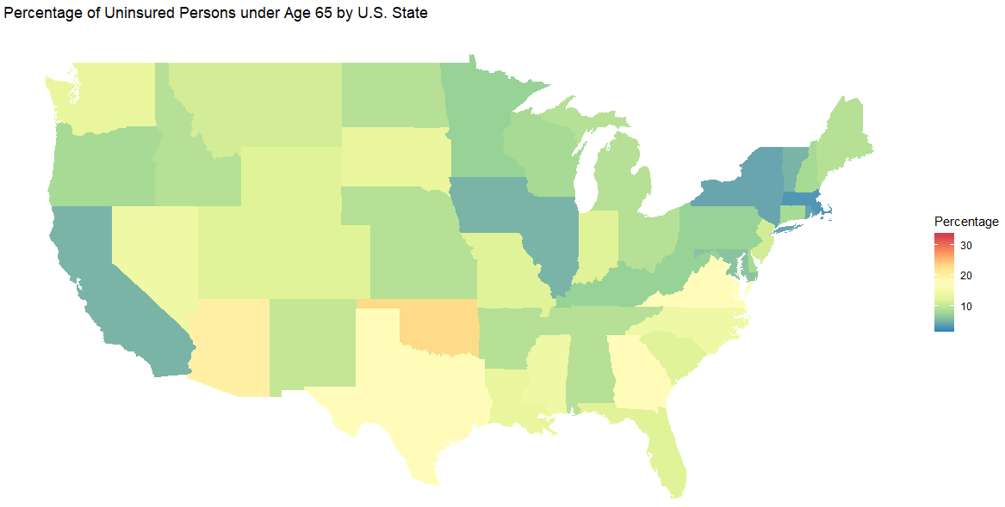
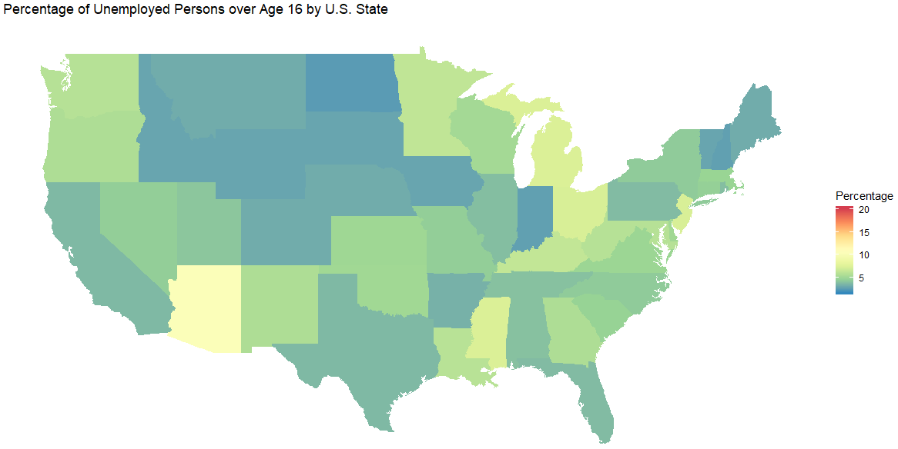
Average Number of Poor Physical Health Days (30-Days)
Average Number of Poor Mental Health Days (30-Days)
Percentage of Uninsured Persons under Age 65
Percentage of Unemployed Persons over Age 16

Slide 9
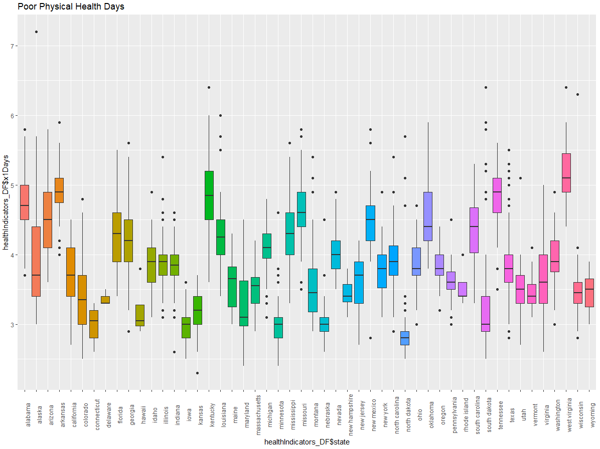
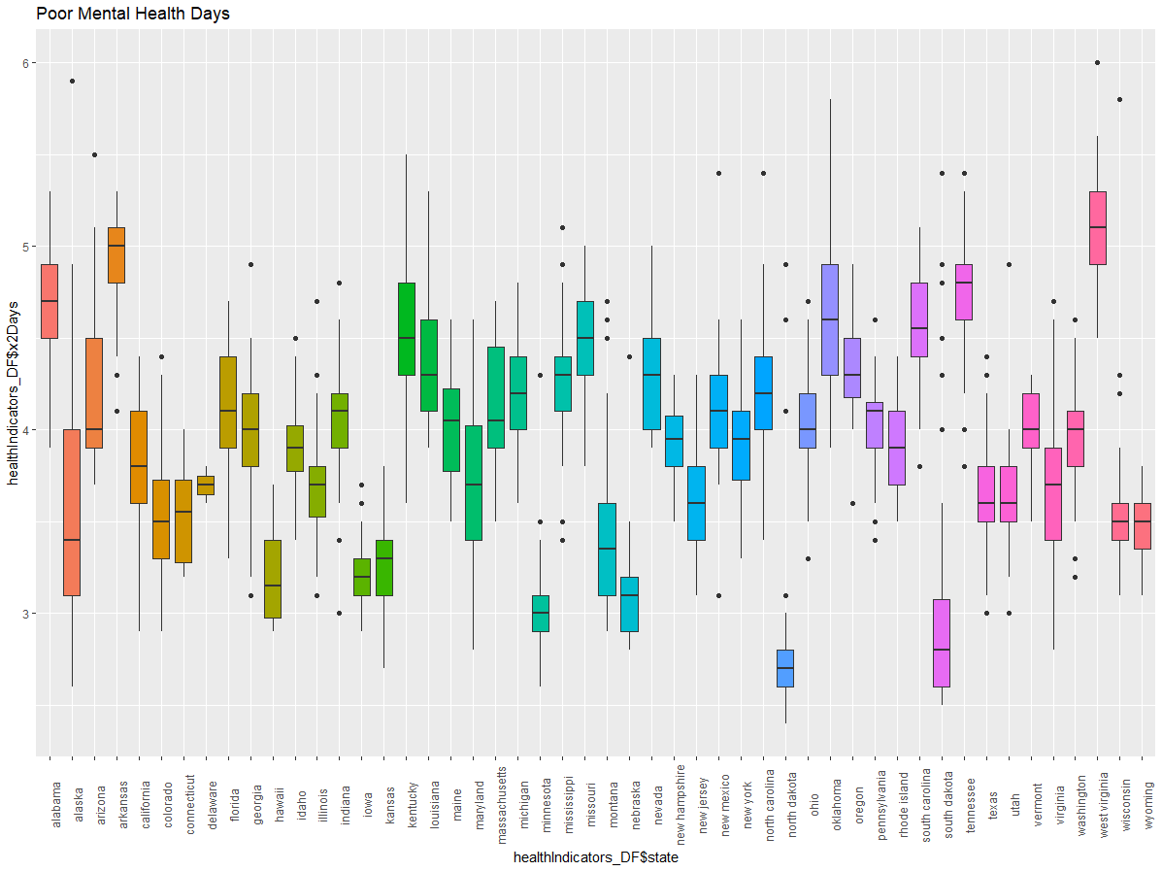
Average Number of Poor Physical Health Days (30-Days)
Average Number of Poor Mental Health Days (30-Days)

Slide 10
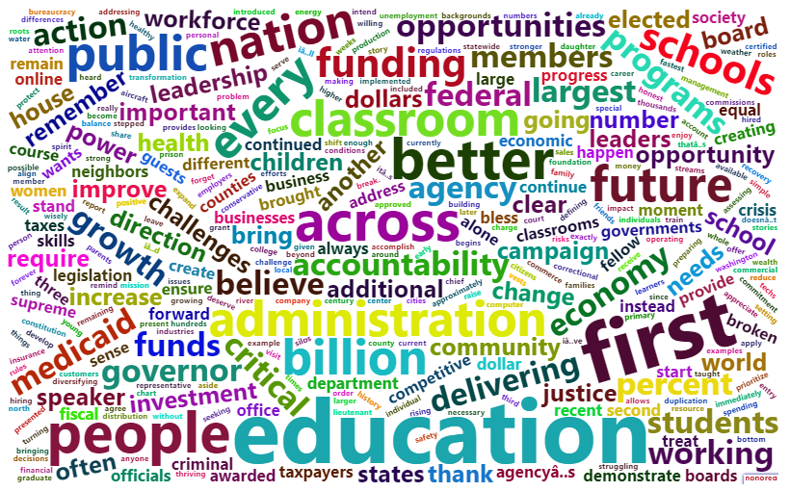
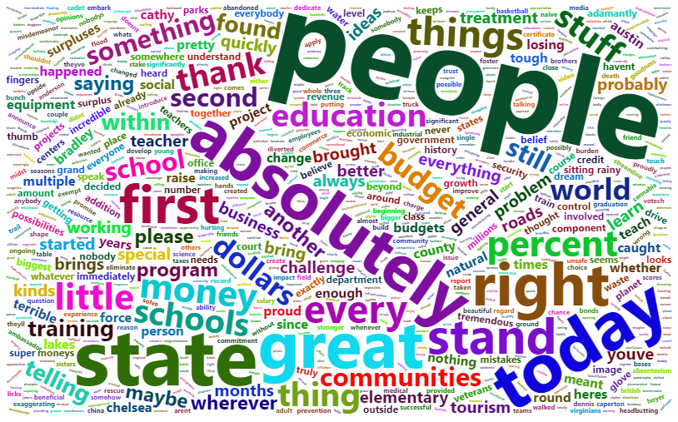
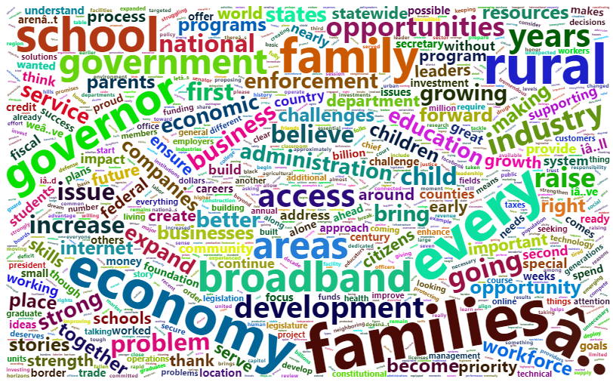
The Words of Oklahoma
The Words of West Virginia
The Words of South Dakota
Notes:
Leaders in areas of struggling health and well-being (OK and WV in this case) appear to focus on optimism (“opportunities, future, better, believe, absolutely, people”); versus those in more thriving areas of well-being that seem to focus on more specific growth actions (business, economy, access, development, school, expand, industry, families).

Slide 11
The sentiments of political parties.
Do political party positions, as expressed through their words, elicit certain emotions that may have an impact on our health and well-being?

Slide 12
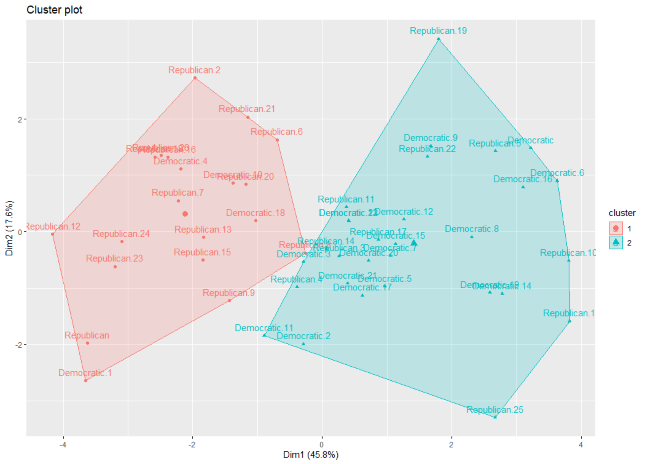
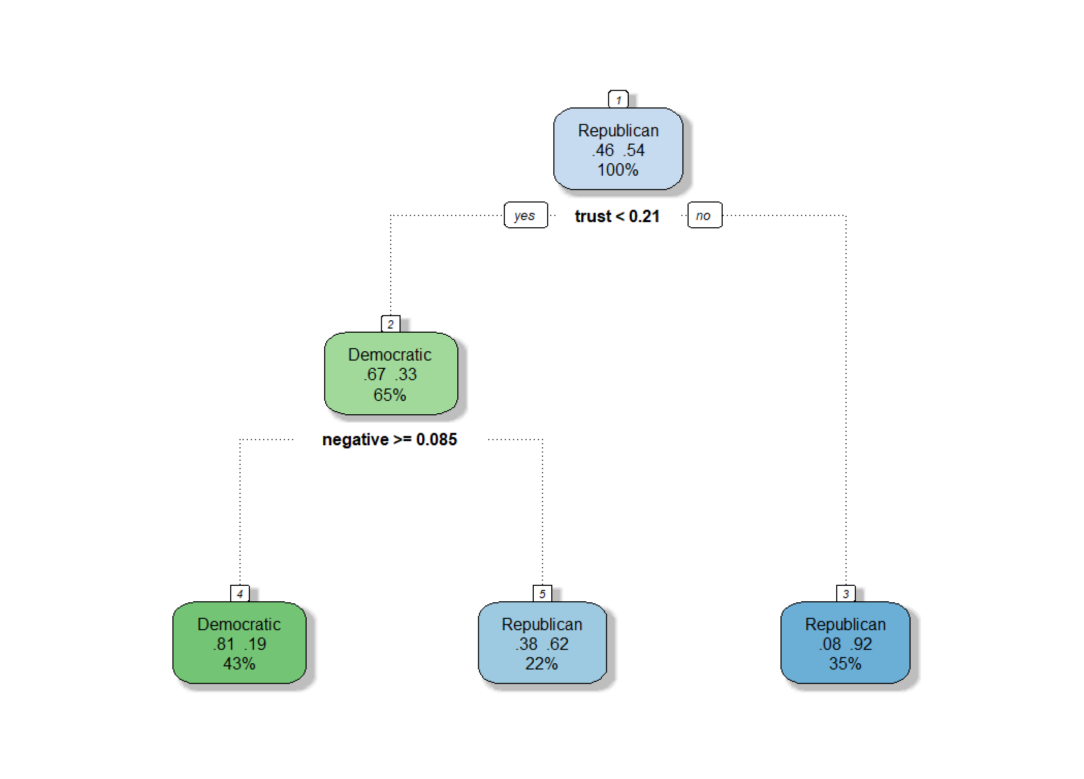
Political Affiliation Classified by Emotion
Emotion and Sentiment that Signal State Political Affiliation
"Emotion refers to a complex psychological state such as happiness, anger, jealousy, grief, etc. Sentiment, on the other hand, can be defined as a mental attitude that is created through the existence of the emotion."
Notes:
(Plot 1) Significance of each cluster
General shape (outliers and centroids)
Variables involved in the clustering
(DT) Key Variables involved in classifying states political affiliation
Defining each criterion and the consequence of fulling the conditions (a state is classified republican if the overall ‘trust’ of a governors speech occurs more than 21% of the time, for example)

Slide 13
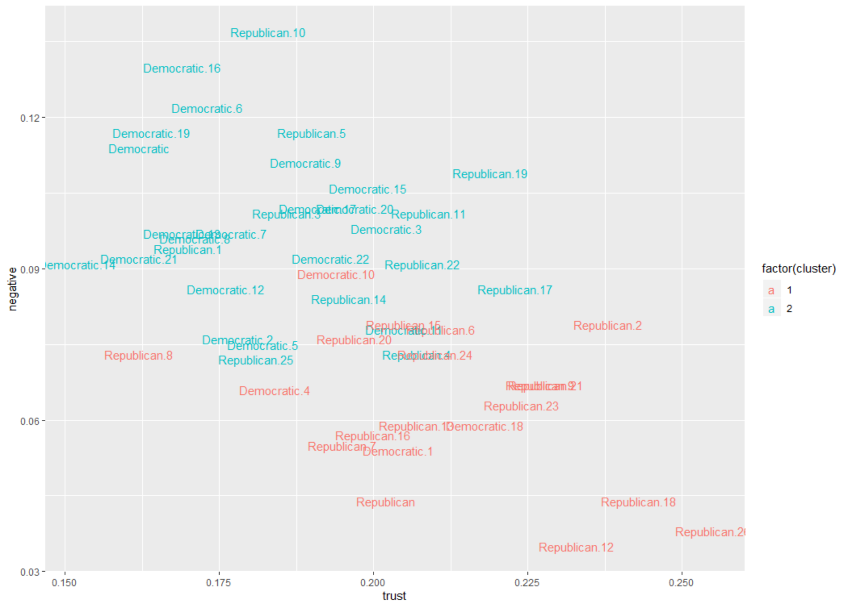
Measures of Trust and Negativity in a political speech can applied differently by political parties and signal a general outlook for the state—a key contributor to personal well-being.
Notes:
Previous cluster plot
Only including the key variables/emotions: trust and negativity
Mention significance of emotions and their role in classifying political parties

Slide 14
Our health and leader emotions.
Do certain emotions and sentiments, as shared by our leaders, persuade or constrain our general health and well-being?
Can certain expressed emotions predict our general health and well-being status?

Slide 15
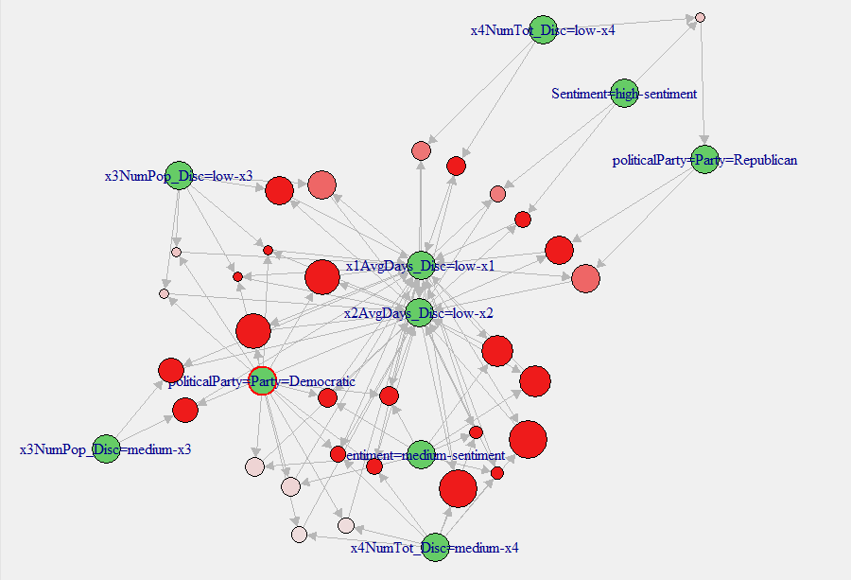
Certain rules can be discovered that associate Democratic party speeches with a broad range of health issues (uninsured, health and wellness, etc.) while Republican party speeches only associate with indicators of poor physical and mental health.

Slide 16
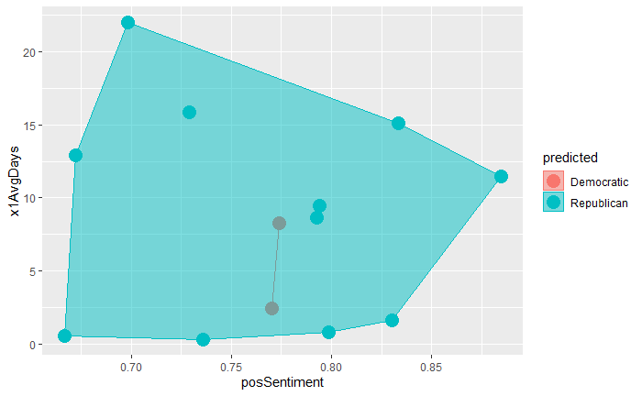
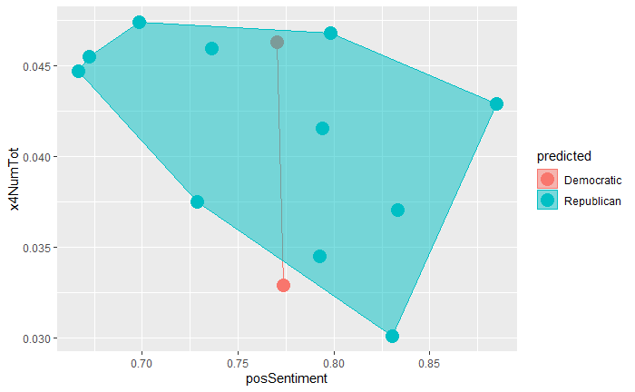
Overlapping decision boundaries indicate a similarity in sentiment regardless of population health. Only when supporting conditions are included does differentiation occur.
Notes:
Supports the Apriori results where we finally have a democratic value outside of the boundary of the republican

Slide 17
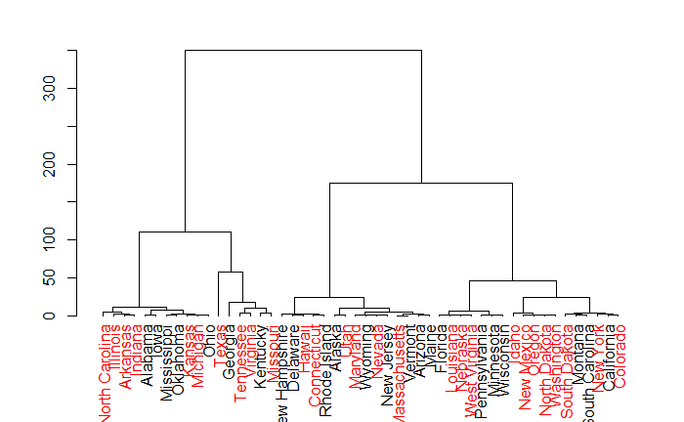
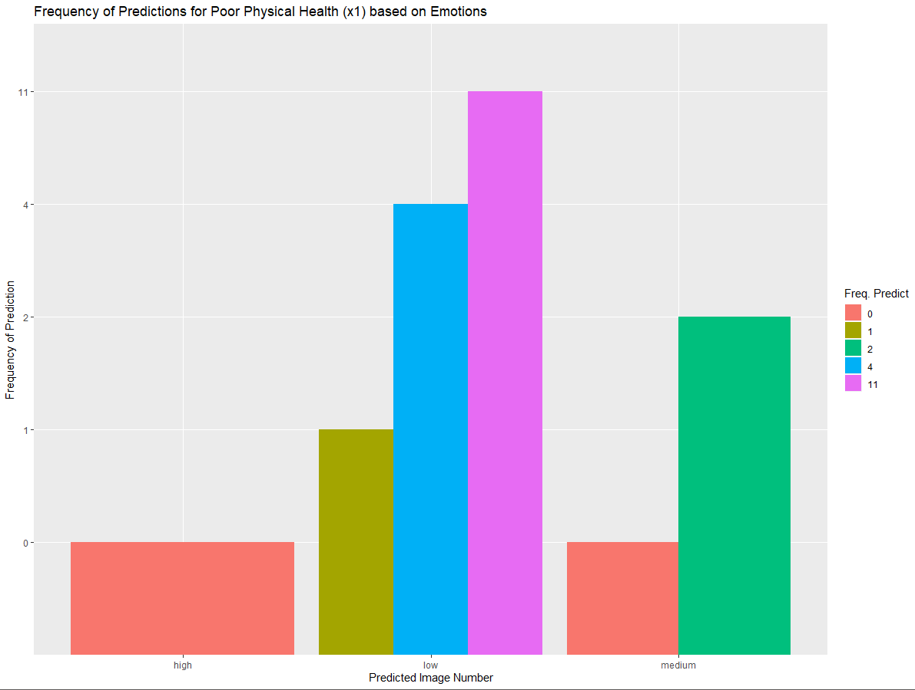
However, there is no evidence that speech sentiment or expressed emotion is a good predictor of population.
Notes:
However there is no evidence that specific emotions and sentiments can accurately predict our general health and welfare. (NB at 65% accuracy – frequency of discrete predictions for x1 from emotions)

Slide 18
Political parties and our health.
Can certain health indicators actually be attributed to a specific political party?
Do political parties recognize that they are associated with specific health and well-being conditions in states?

Slide 19
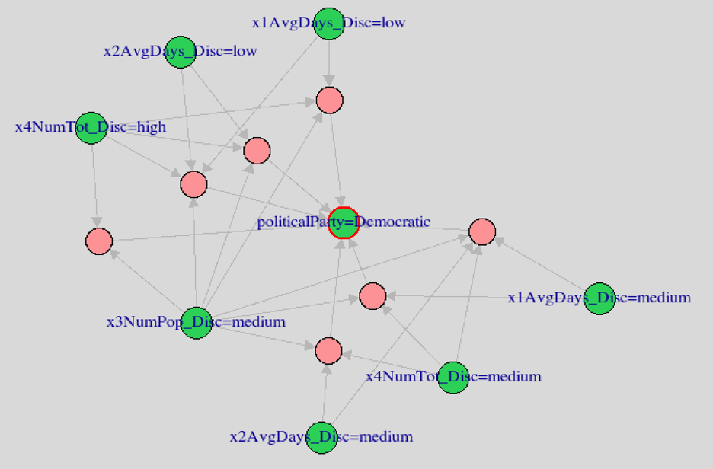
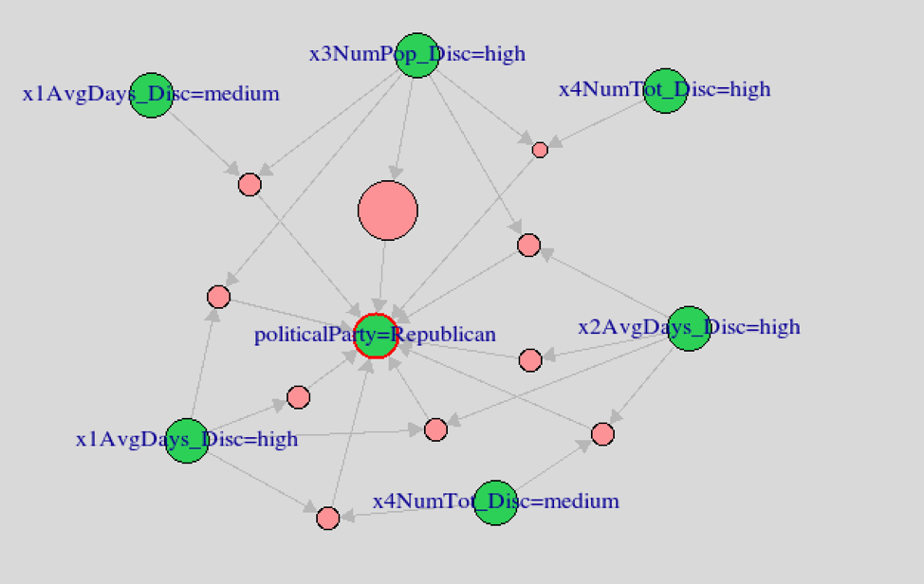
The Health Associations for Democrats
The Health Associations for Republicans

Slide 20
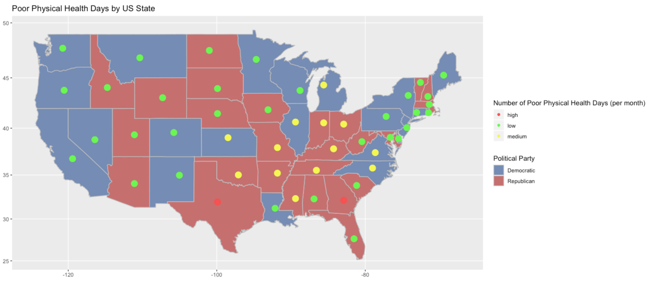
Poor Physical Health Days by State

Slide 21
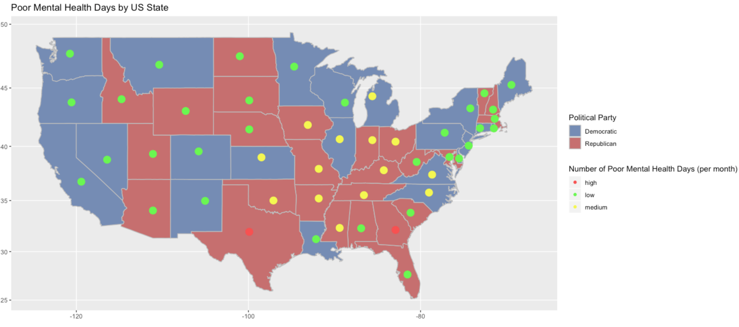
Poor Mental Health Days by State

Slide 22
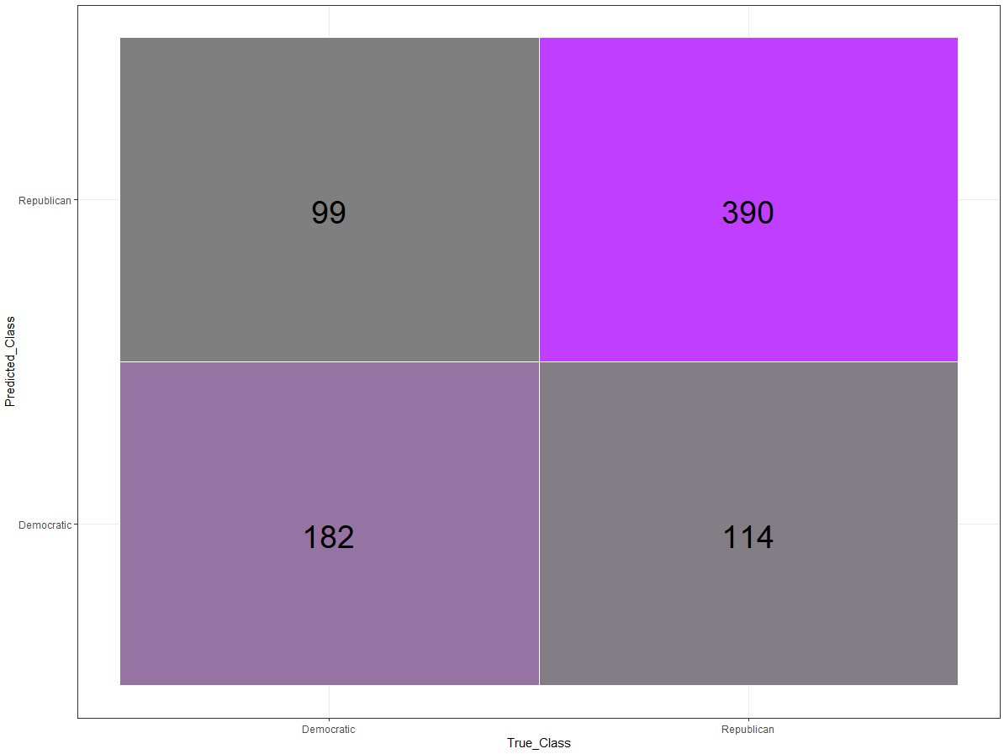
Predicting political party affiliation from health measures of 3,140 counties across the United States.
The selected health indicators predicted political classification with 72.86% accuracy.

Slide 23
Our conclusions.
There is no evidence that specific emotions and sentiments can accurately predict our general health and welfare.
While emotions and sentiments expressed by political leaders are poor predictors of population health, select indicators and determinants of health can be used to classify political parties.
There are distinct emotions and sentiments that appear to be associated with political party affiliation.

